Slide 1

Networks Project Presentation
Scott Ye, Tobias Zheng

Slide 2
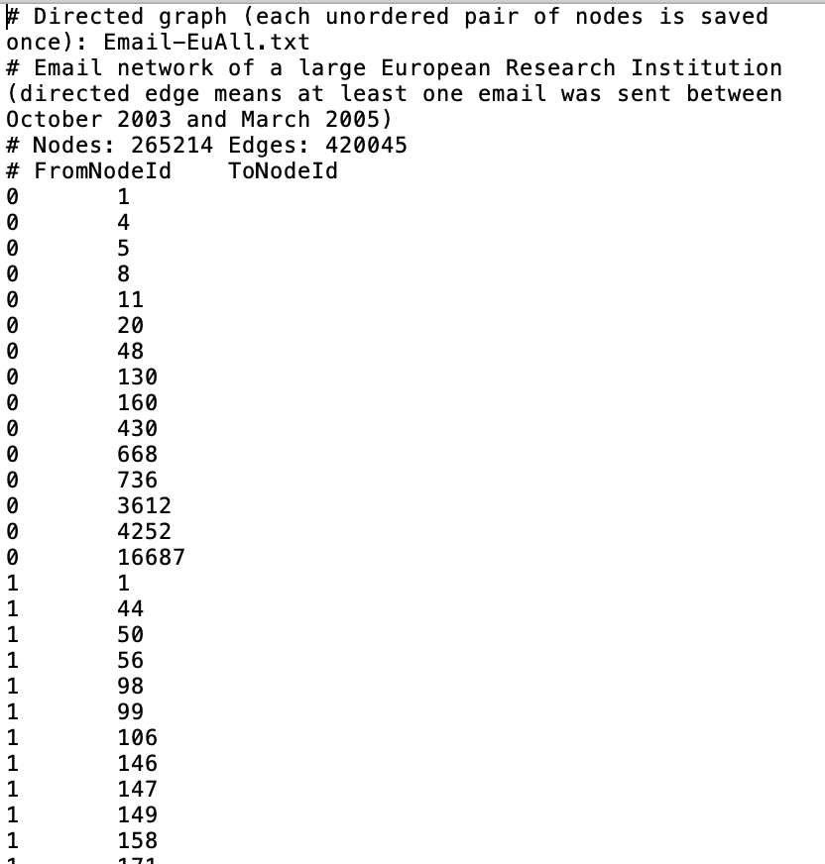
Introduction
EU email communication network
The network was generated using email data from a large European research institution. For a period from October 2003 to May 2005 (18 months) we have anonymized information about all incoming and outgoing email of the research institution.

Slide 3

Prediction
Manager
Group Leader
Associates
CEO
Top Manager
Chief Project Leader
Project Leader
Researcher
Senior Manager
We predict that the central contact form of a research institution is quite the same as the the form of a company:
1. A clear leadership hierarchy.
2. There exist several hubs that are easy to identify.

Slide 4
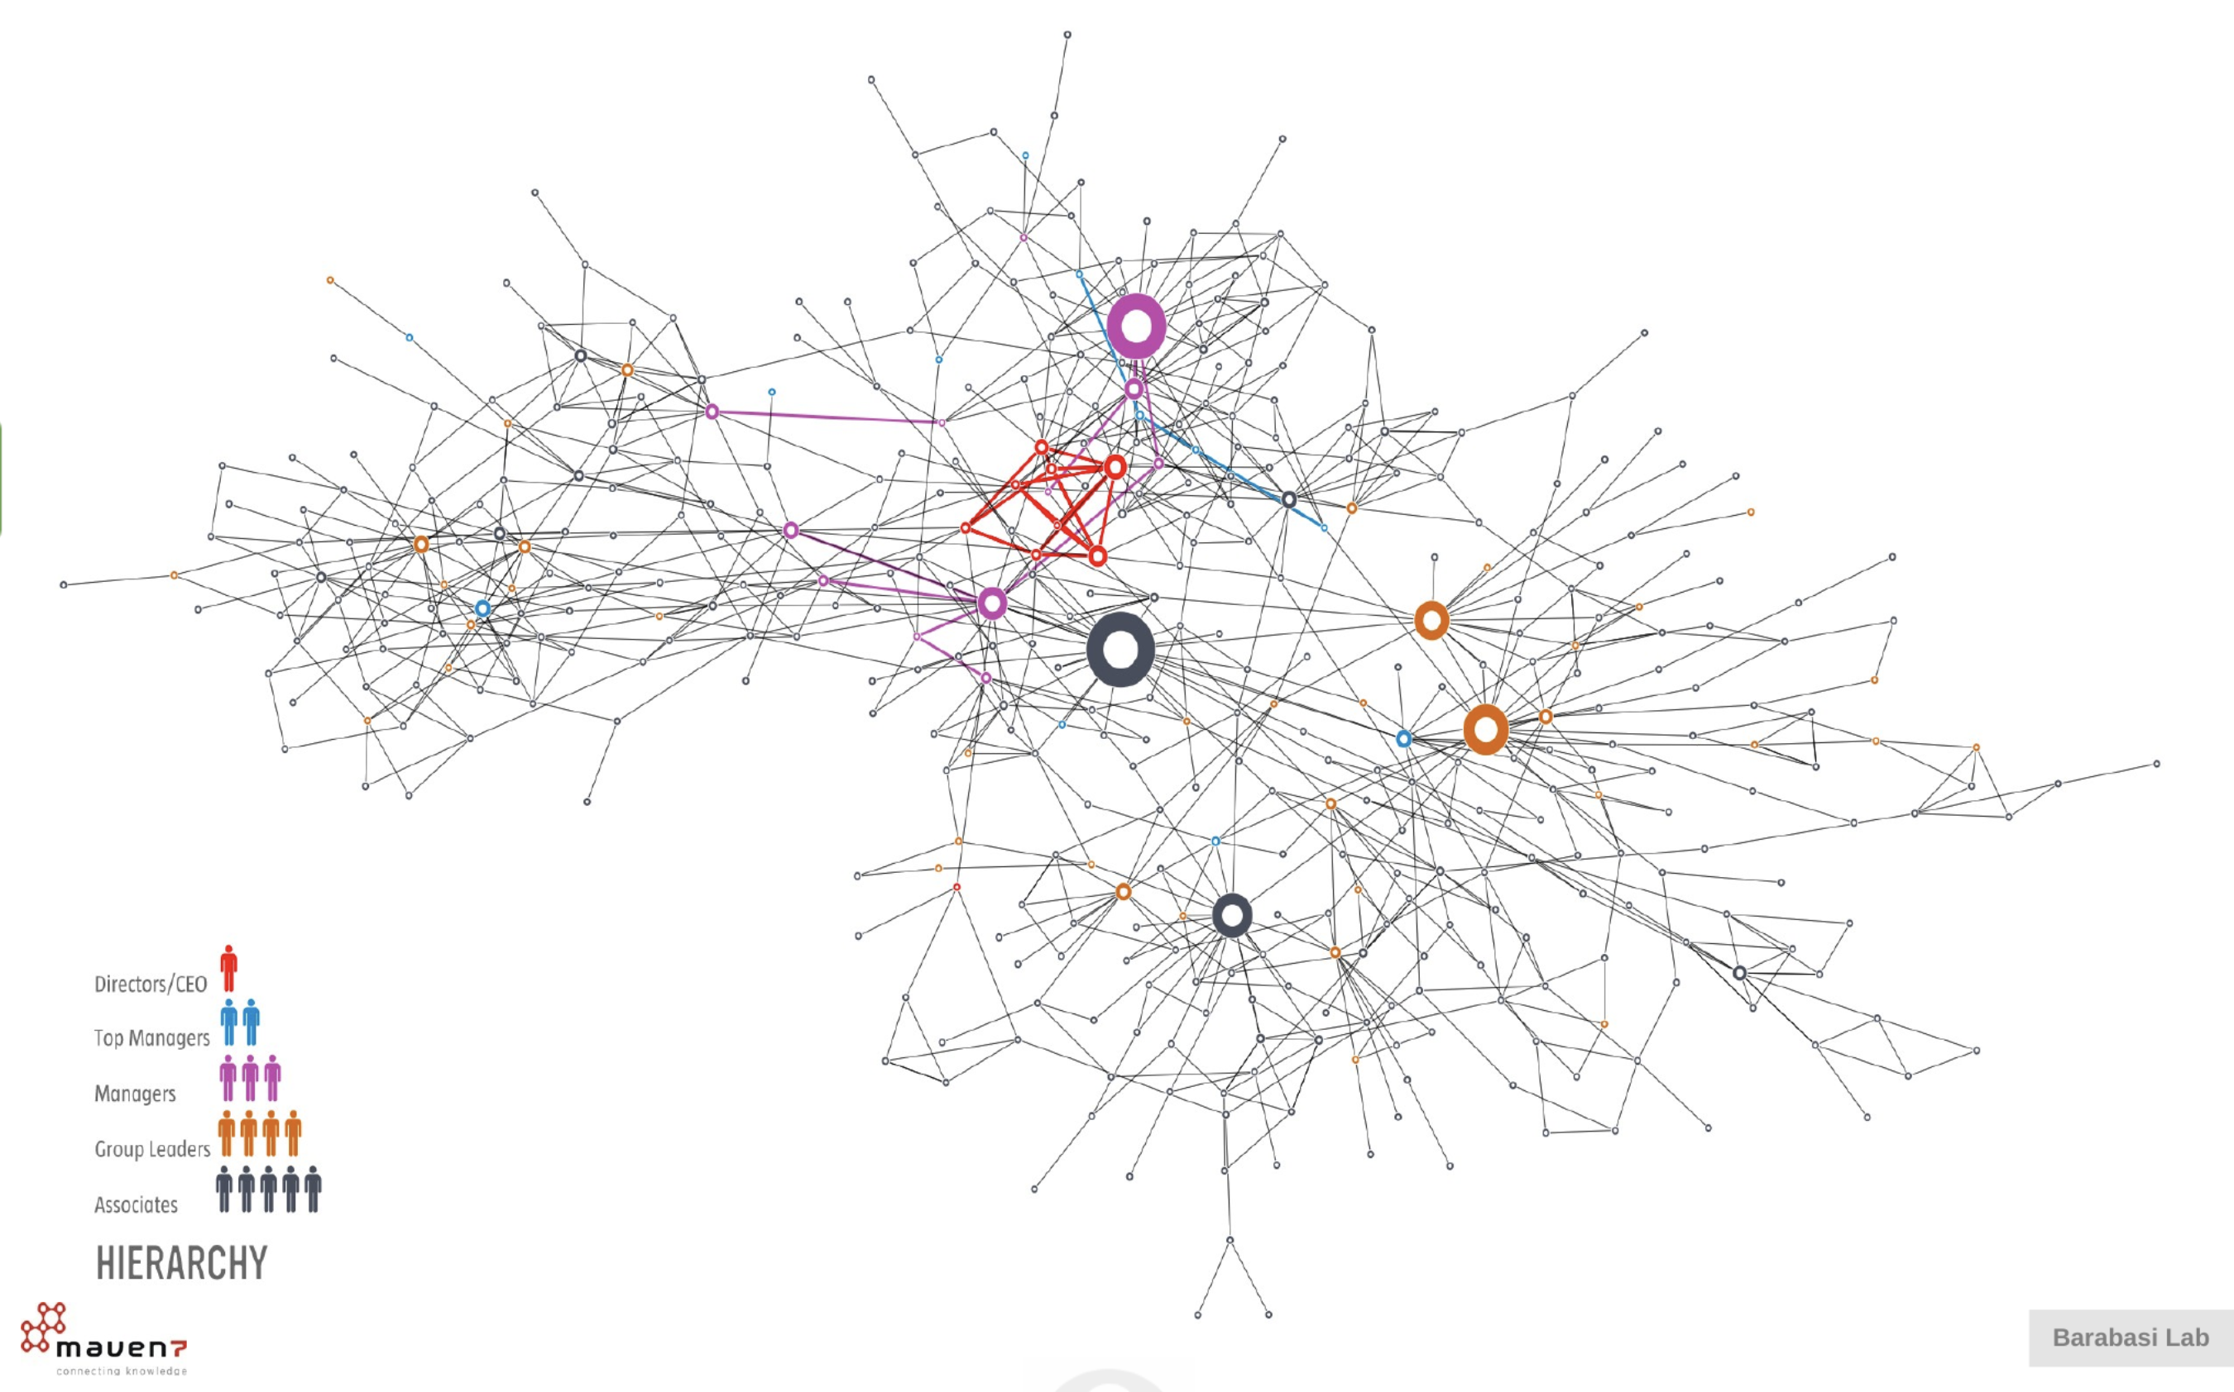

Slide 5
GENERAL QUESTION
What’s the pattern of collaboration within this research institution?
What is the effect of removing the most central nodes?
Are there any potential influencers other than the central node with the highest centrality?

Slide 6

Measurement
We use several functions to analysis the property of the network.
Information that we primarily focus on:
1. General Network Info
2. Centrality
3. Degree Distribution
4. Clustering
5. Largest Component

Slide 7
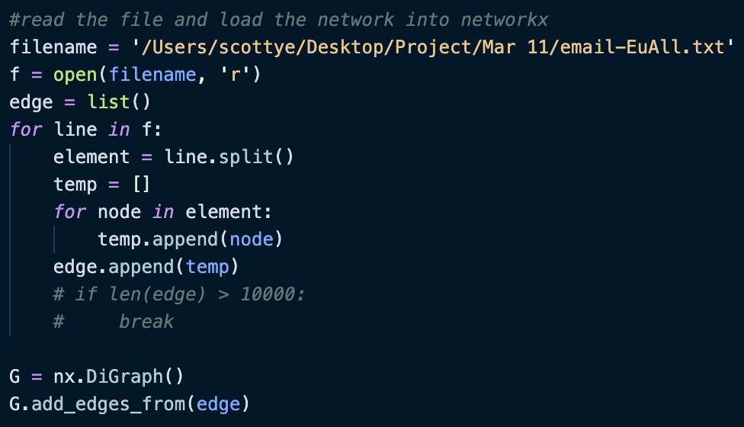
Load the Network

Slide 8
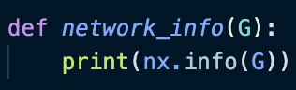
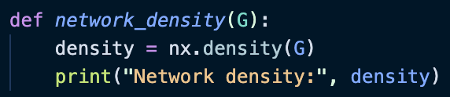
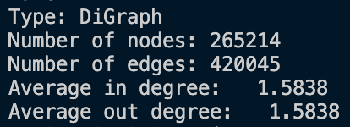

Slide 9
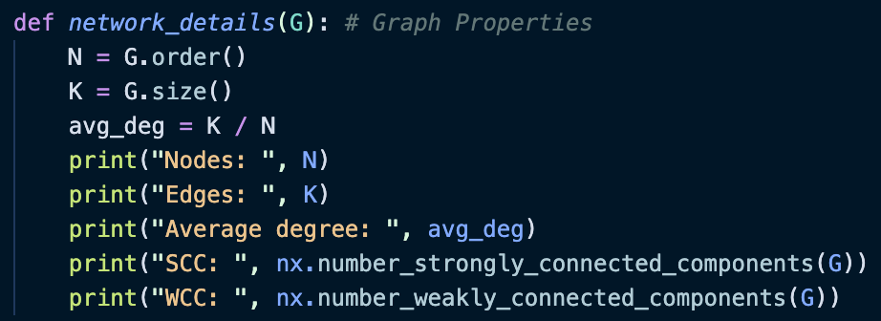
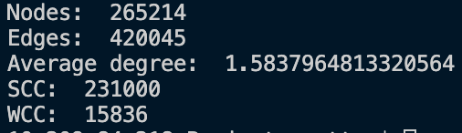

Slide 10

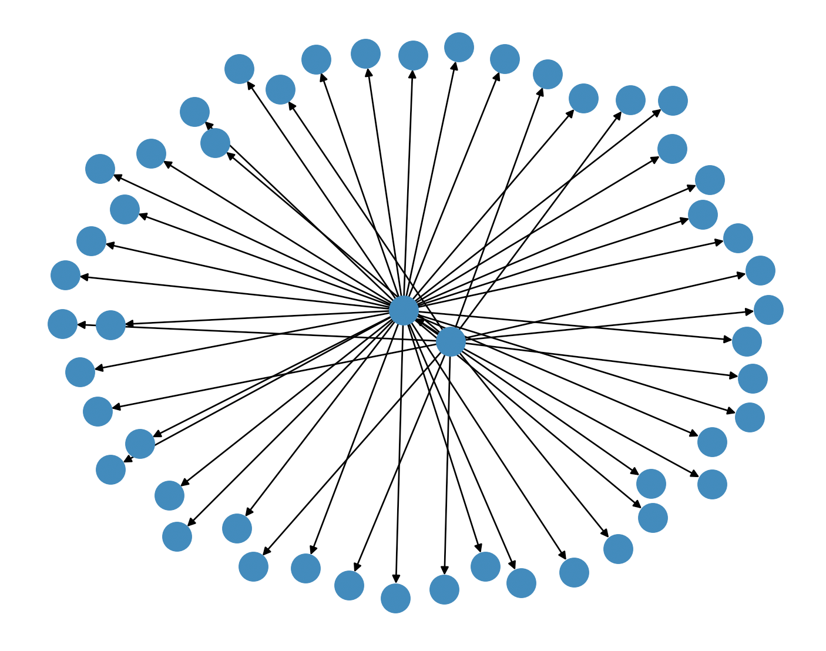
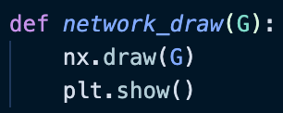
Plot the Network
L = 50
Similar to the management network of a company?

Slide 11
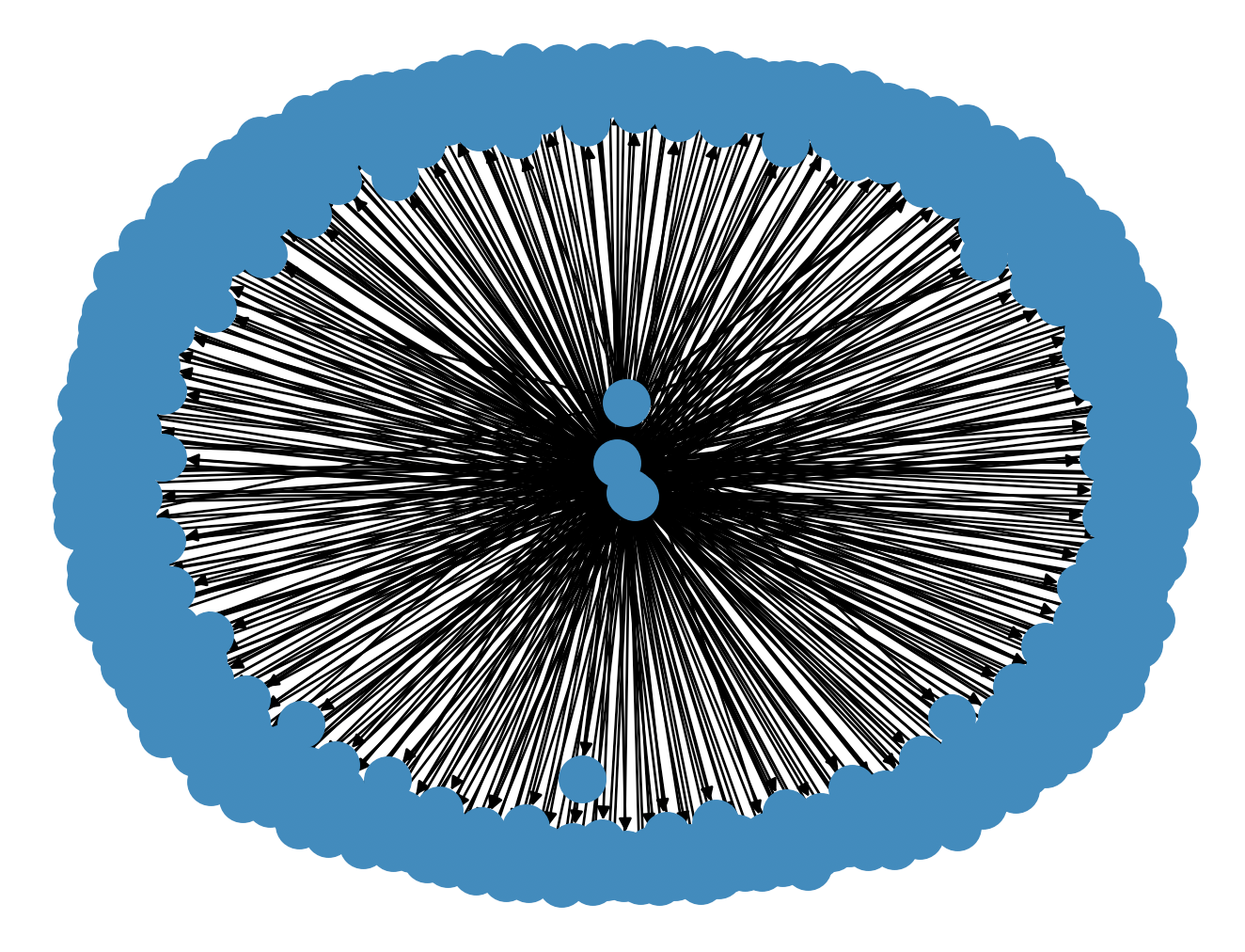
Plot the Network
L = 500
Still similar

Slide 12
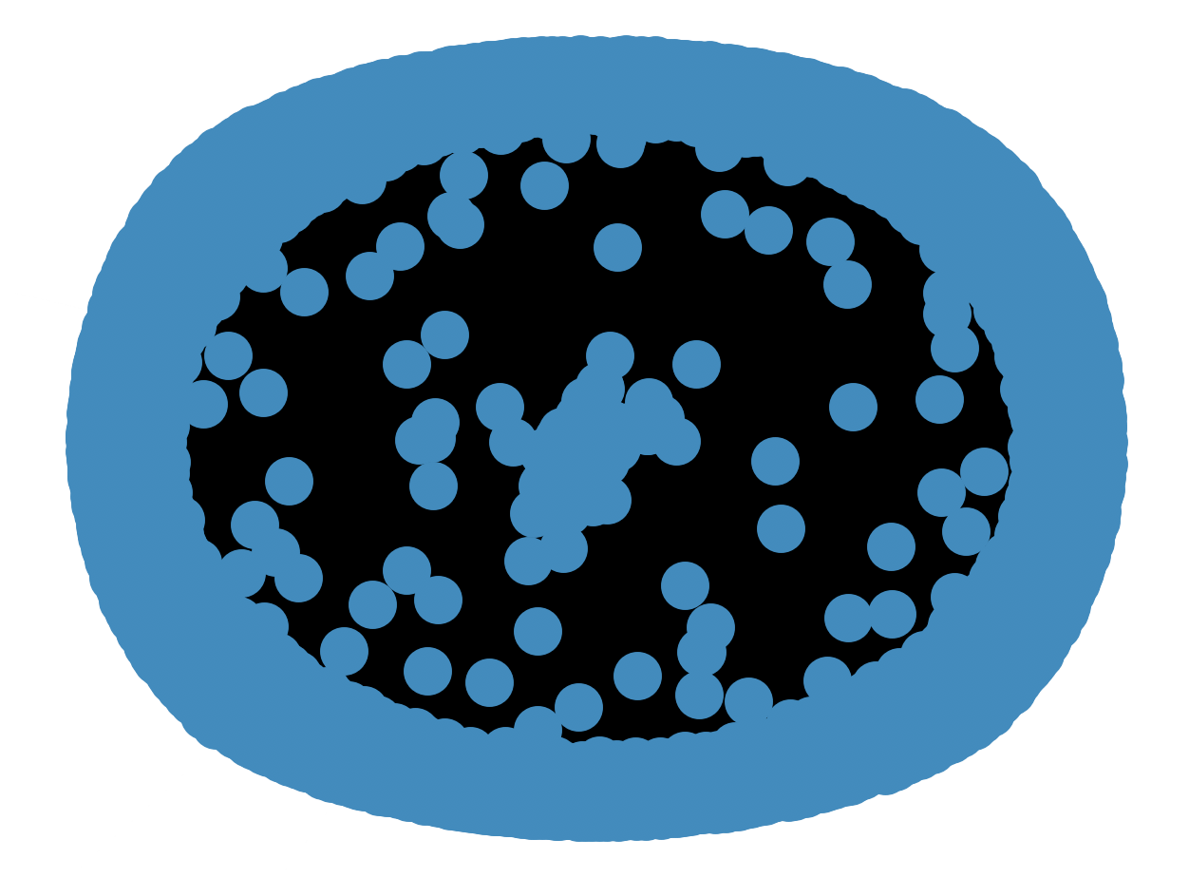
L=10,000
Sharp Difference

Slide 13
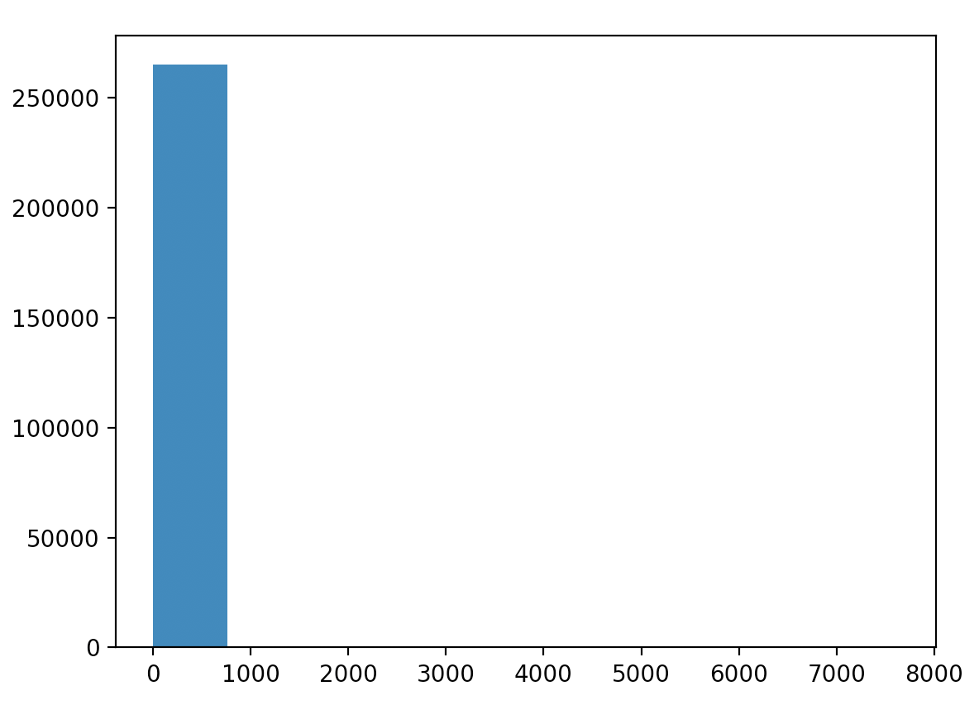
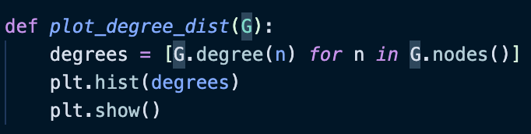
Degree Distribution

Slide 14
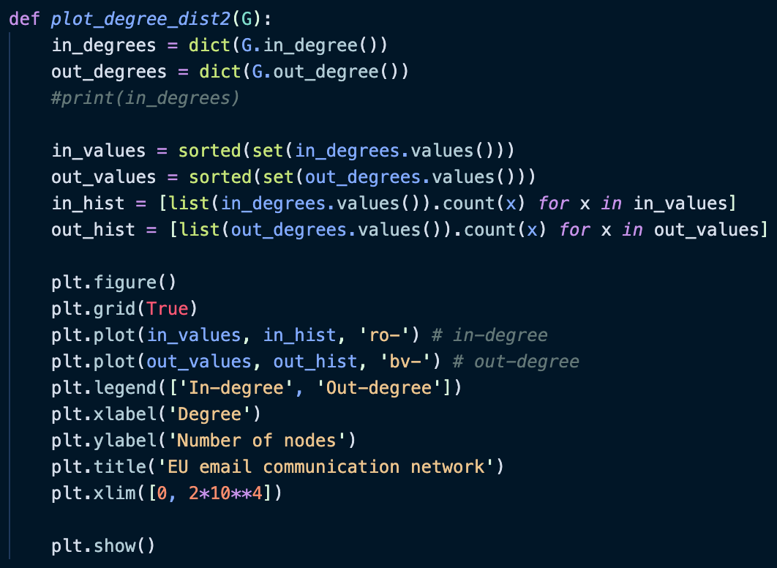
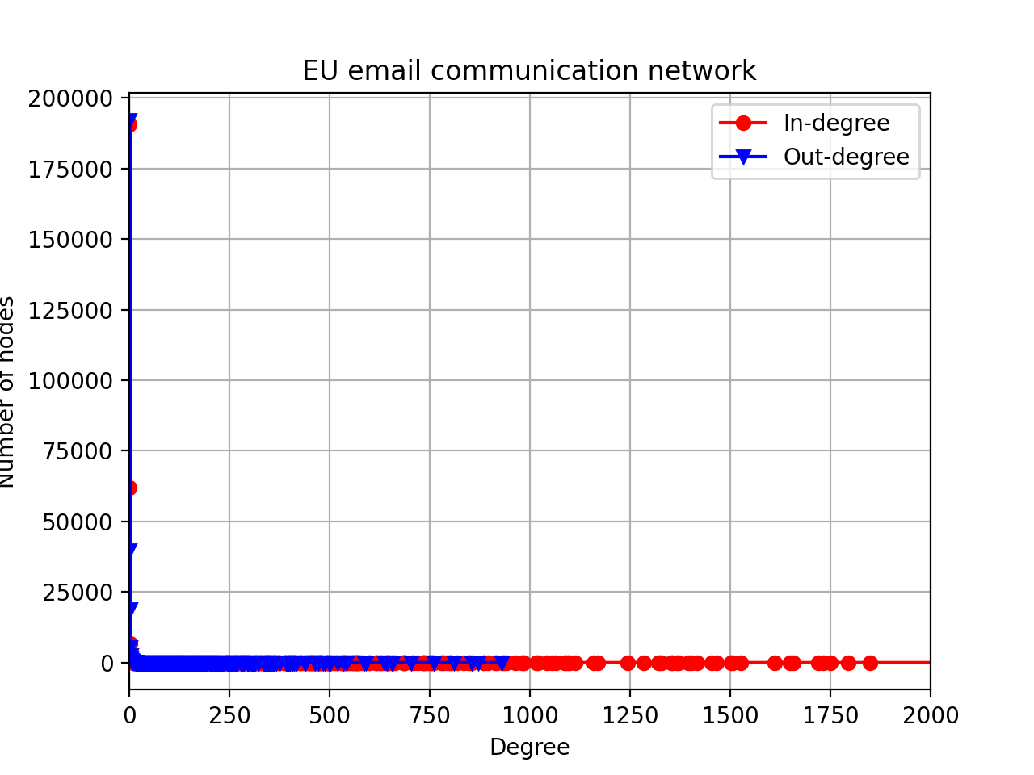
Degree Distribution

Slide 15
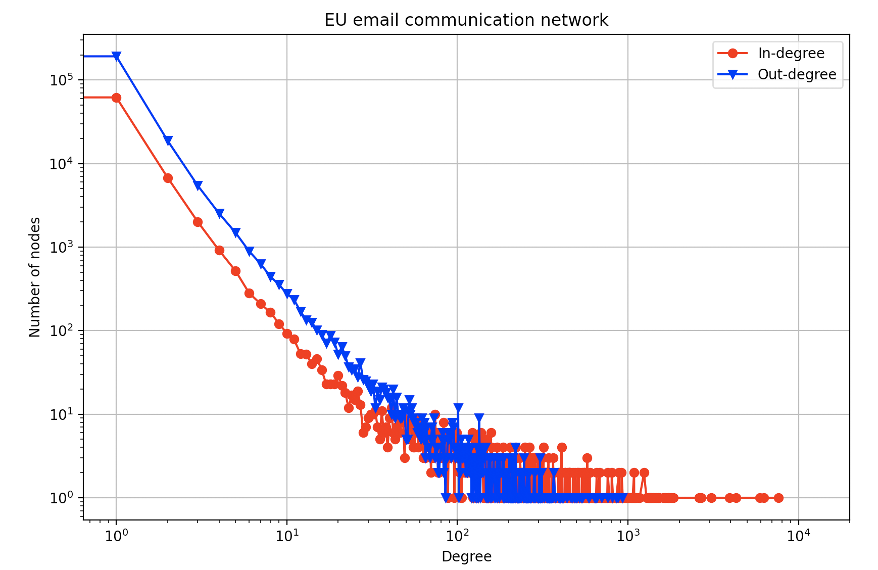
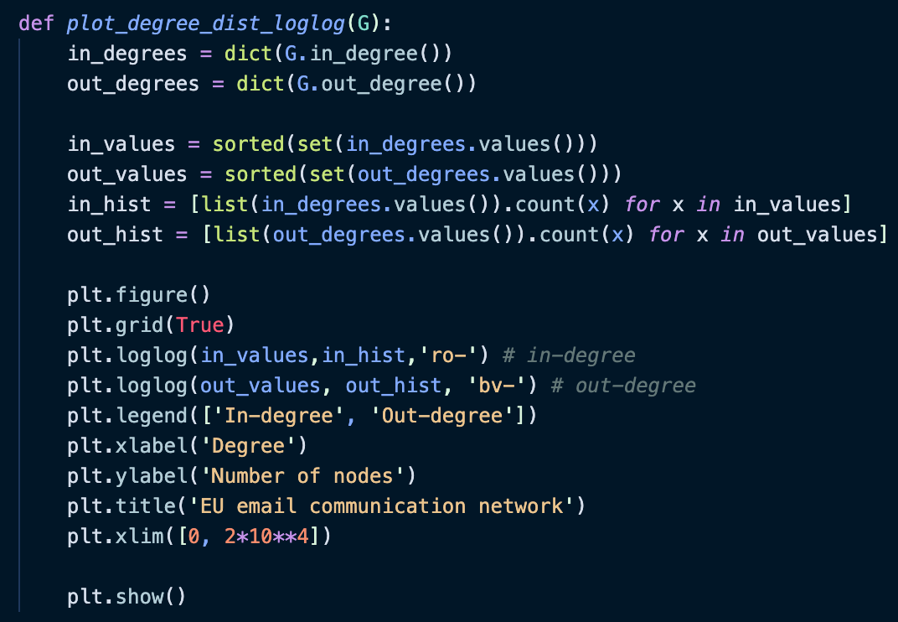
Degree Distribution

Slide 16
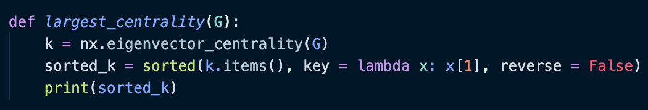
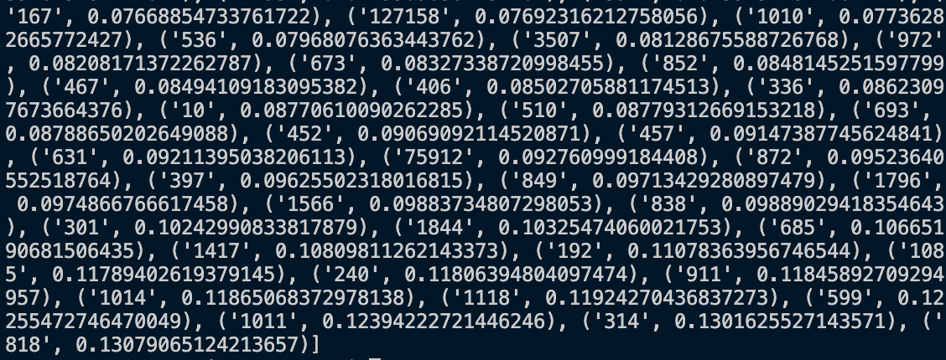
Central Nodes

Slide 17
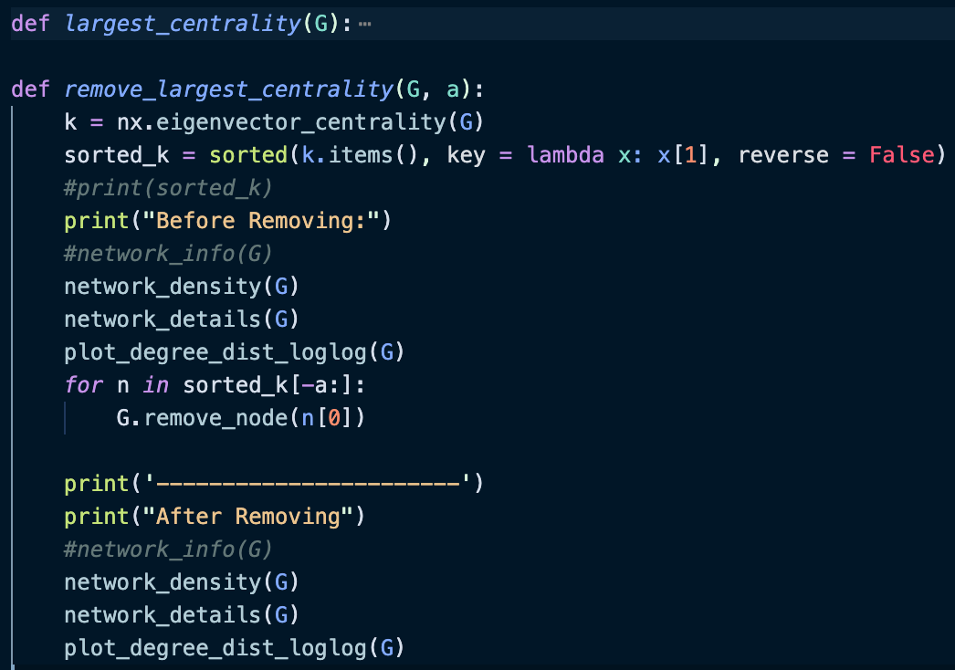
Try to Remove Several Central Nodes

Slide 18

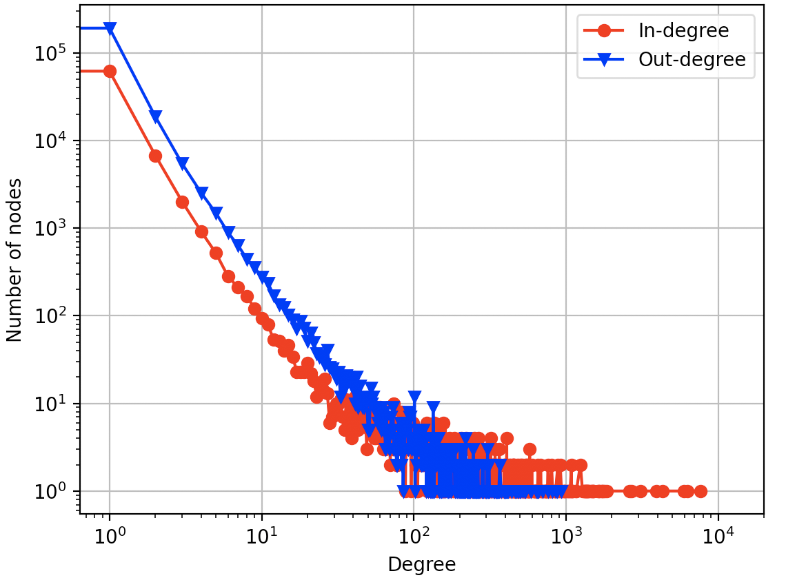
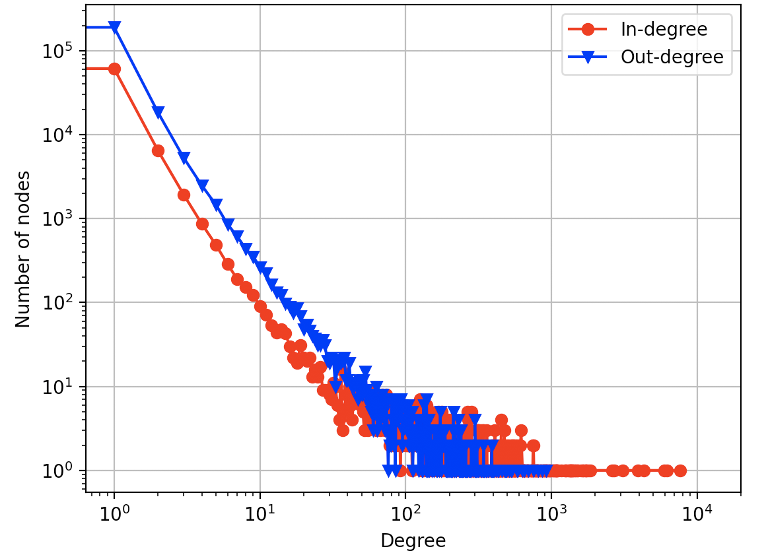
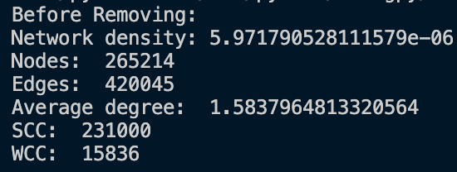
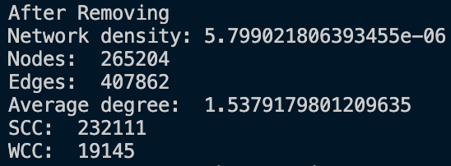
Before vs. After (10 nodes)

Slide 19
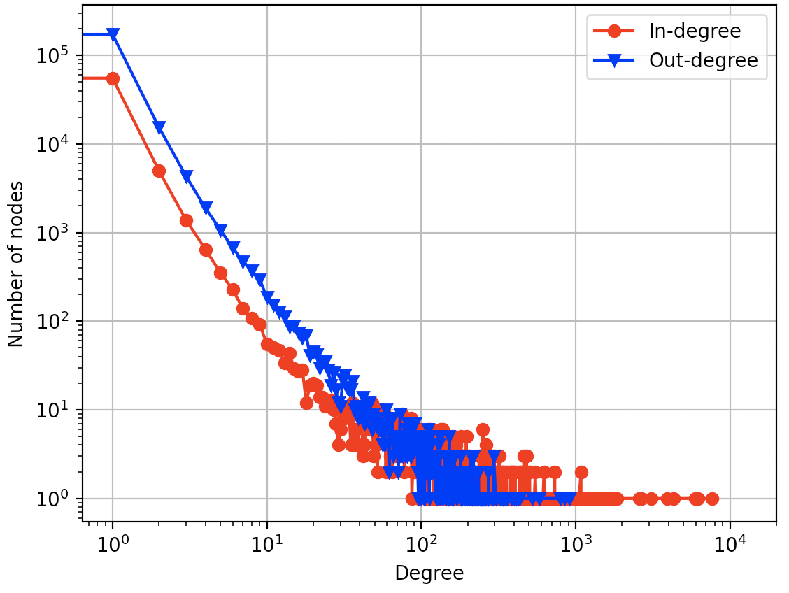
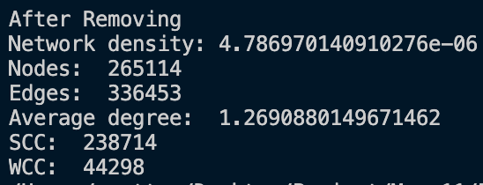
Before vs. After (100 nodes)

Slide 20
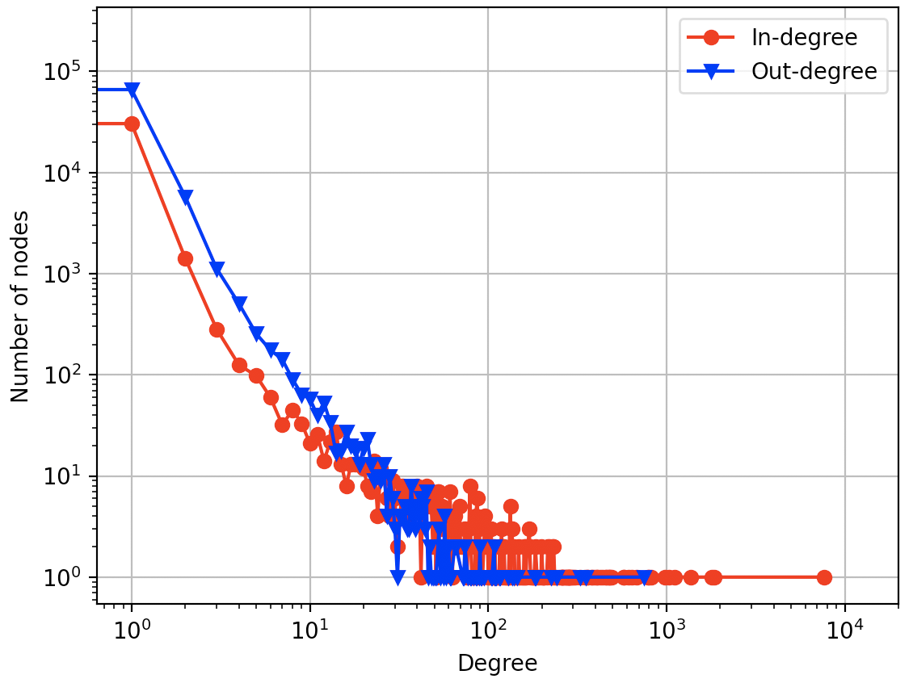
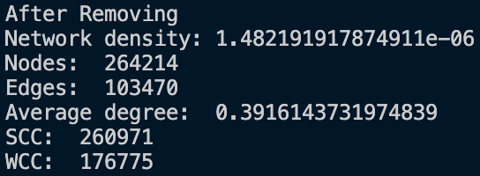
Before vs. After (1,000 nodes)

Slide 21
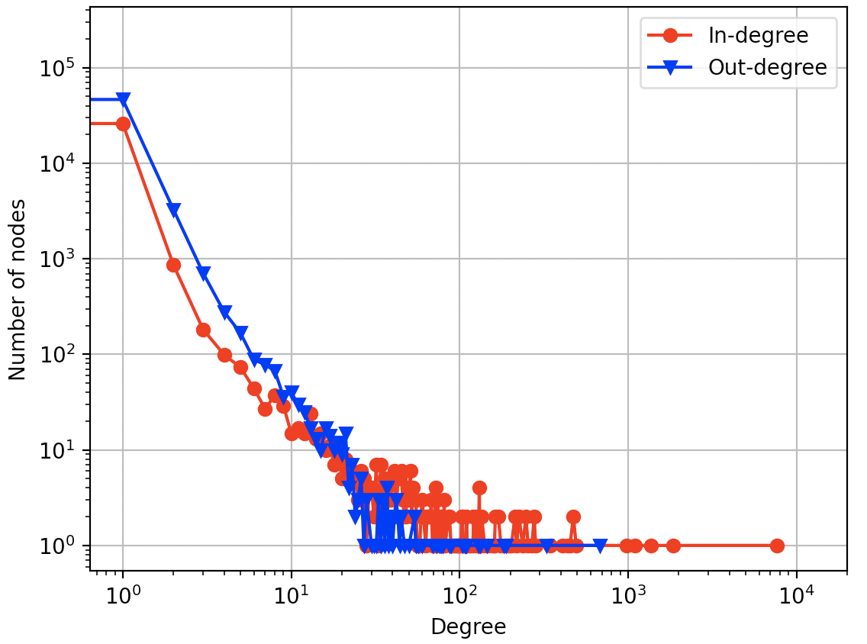
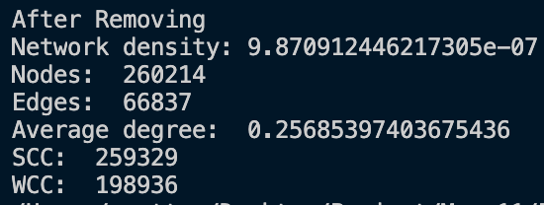
Before vs. After (5,000 nodes)

Slide 22
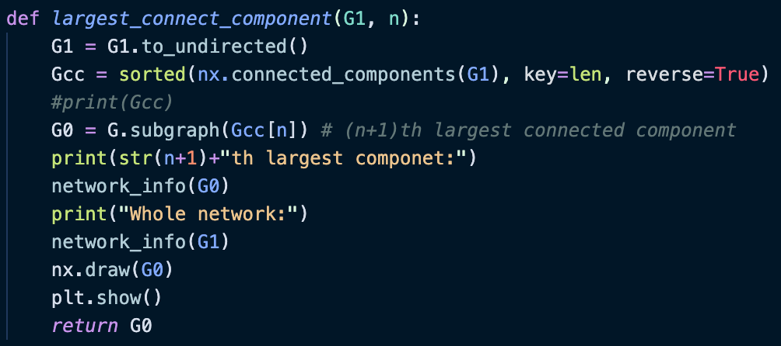
Nth Largest Component

Slide 23
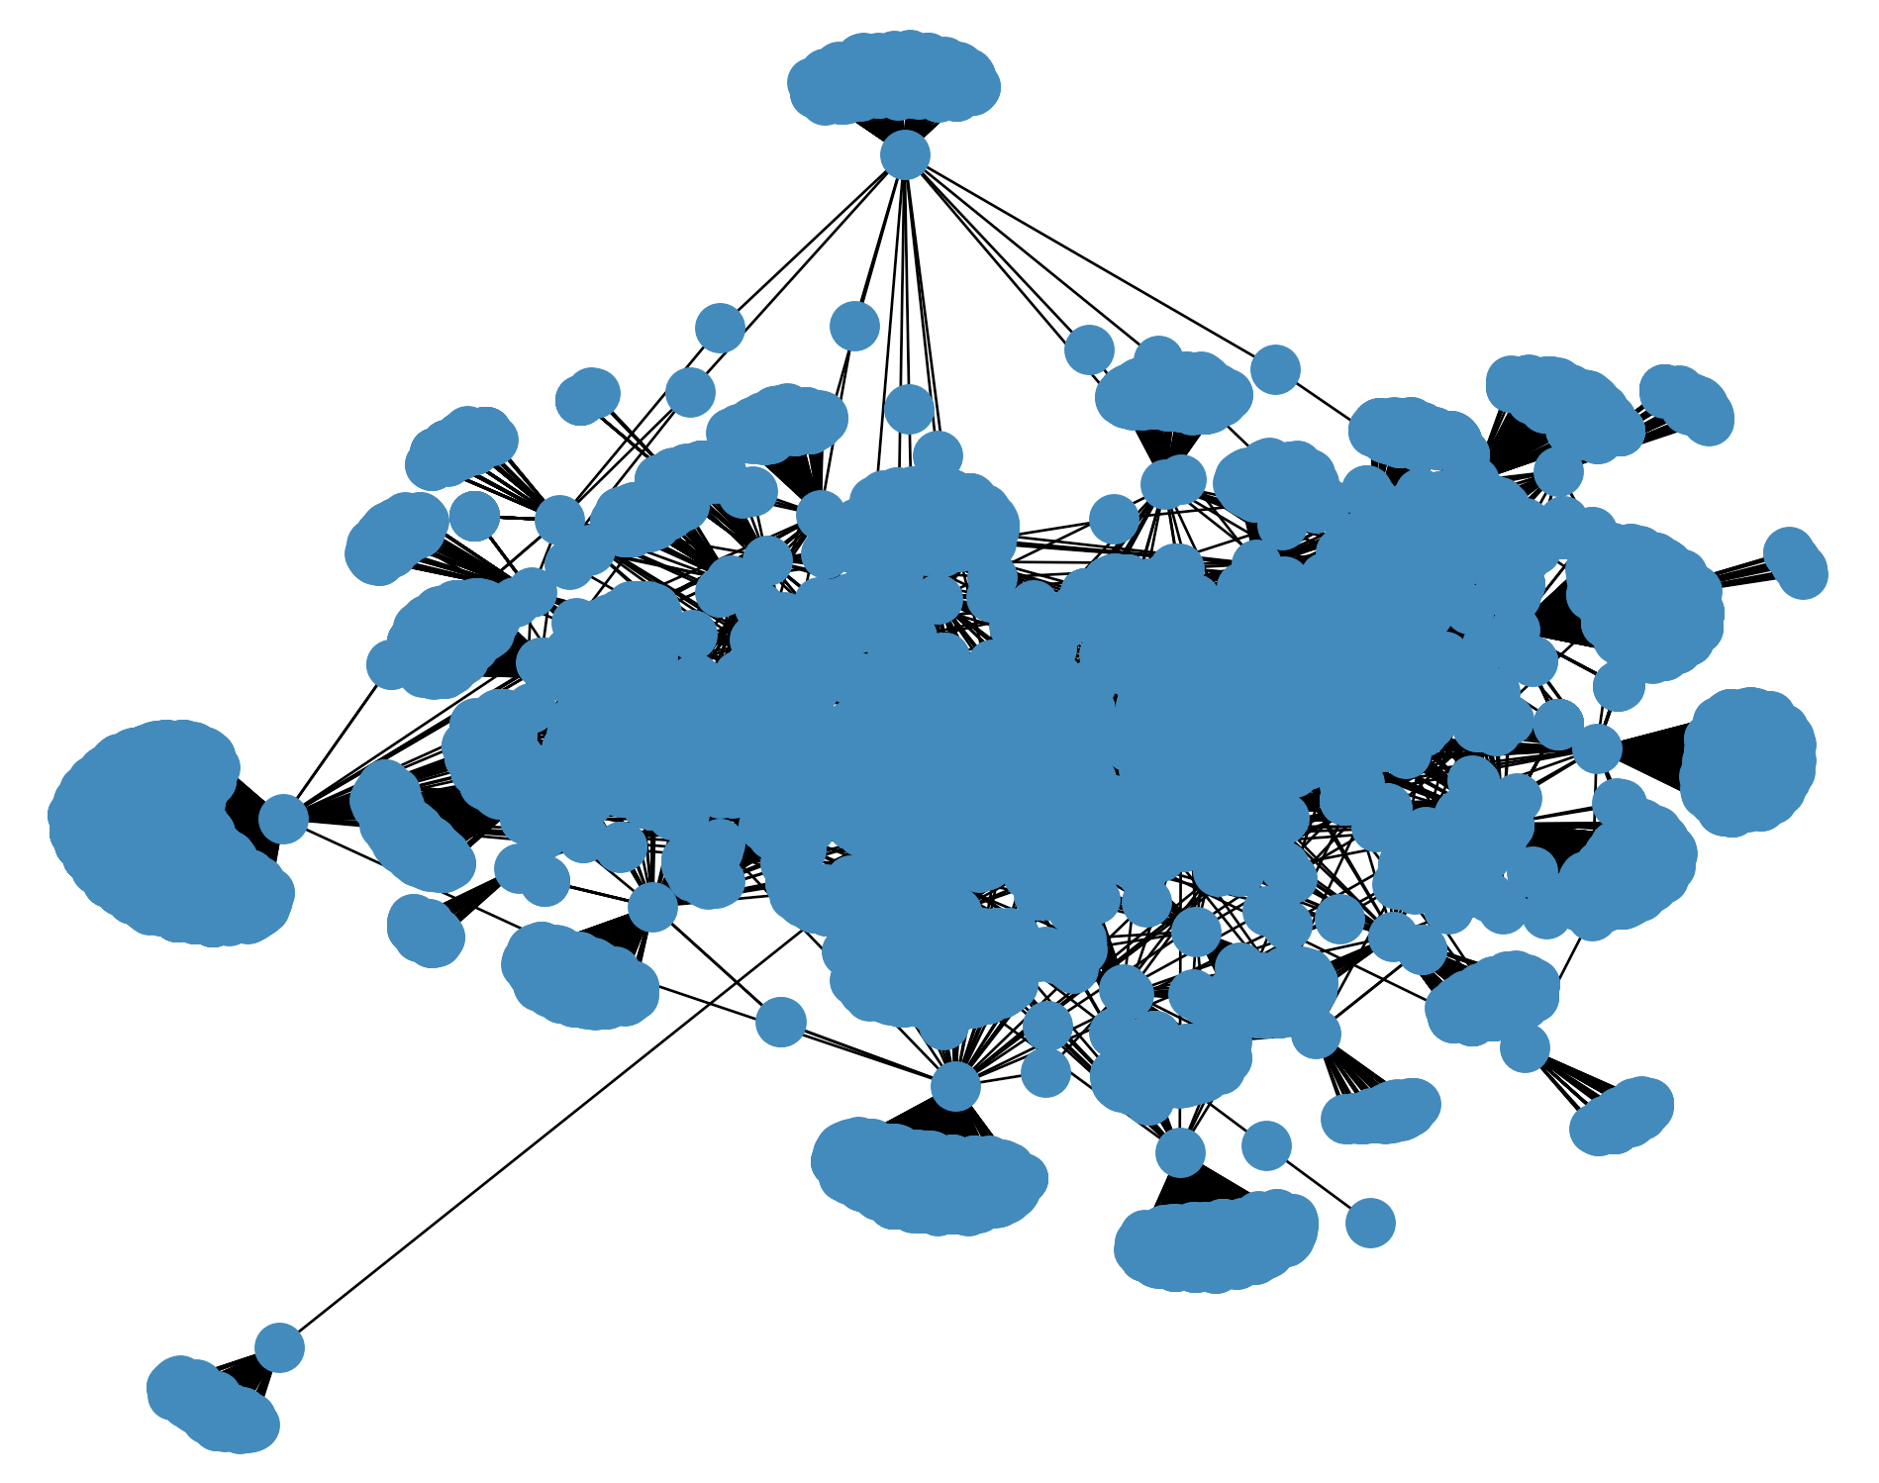
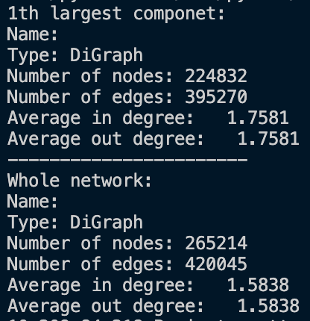
1st Largest Component
When N = 7879 (not completely graphed)

Slide 24
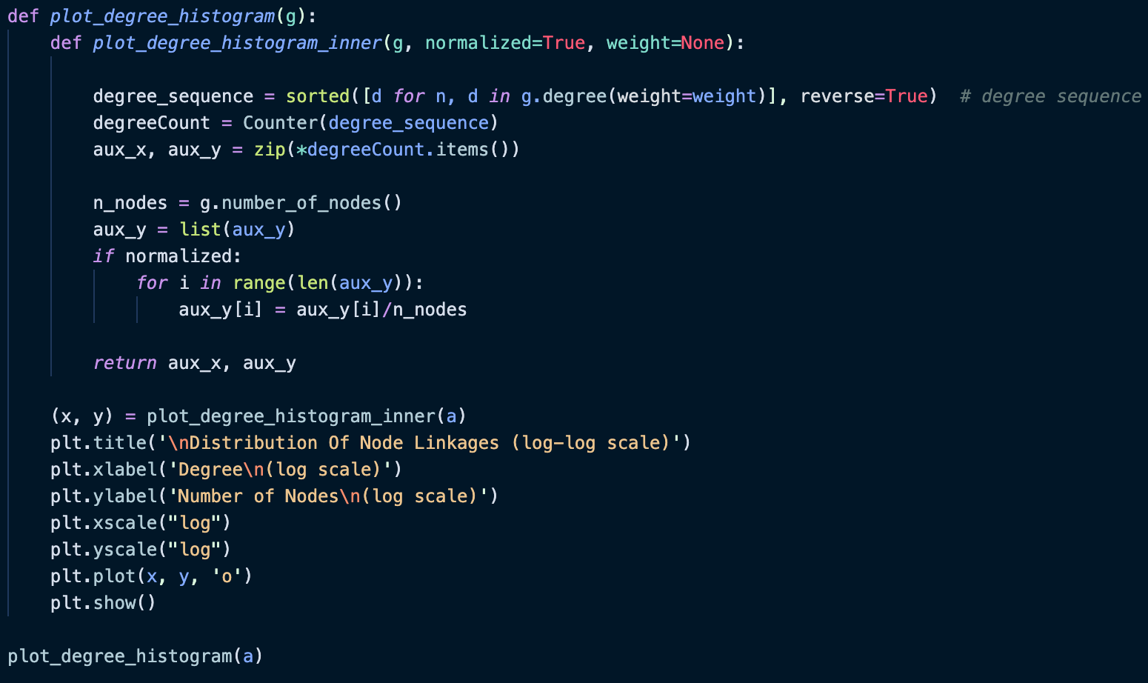
Degree Distribution of the 1st Large Component (Undirected Version)

Slide 25
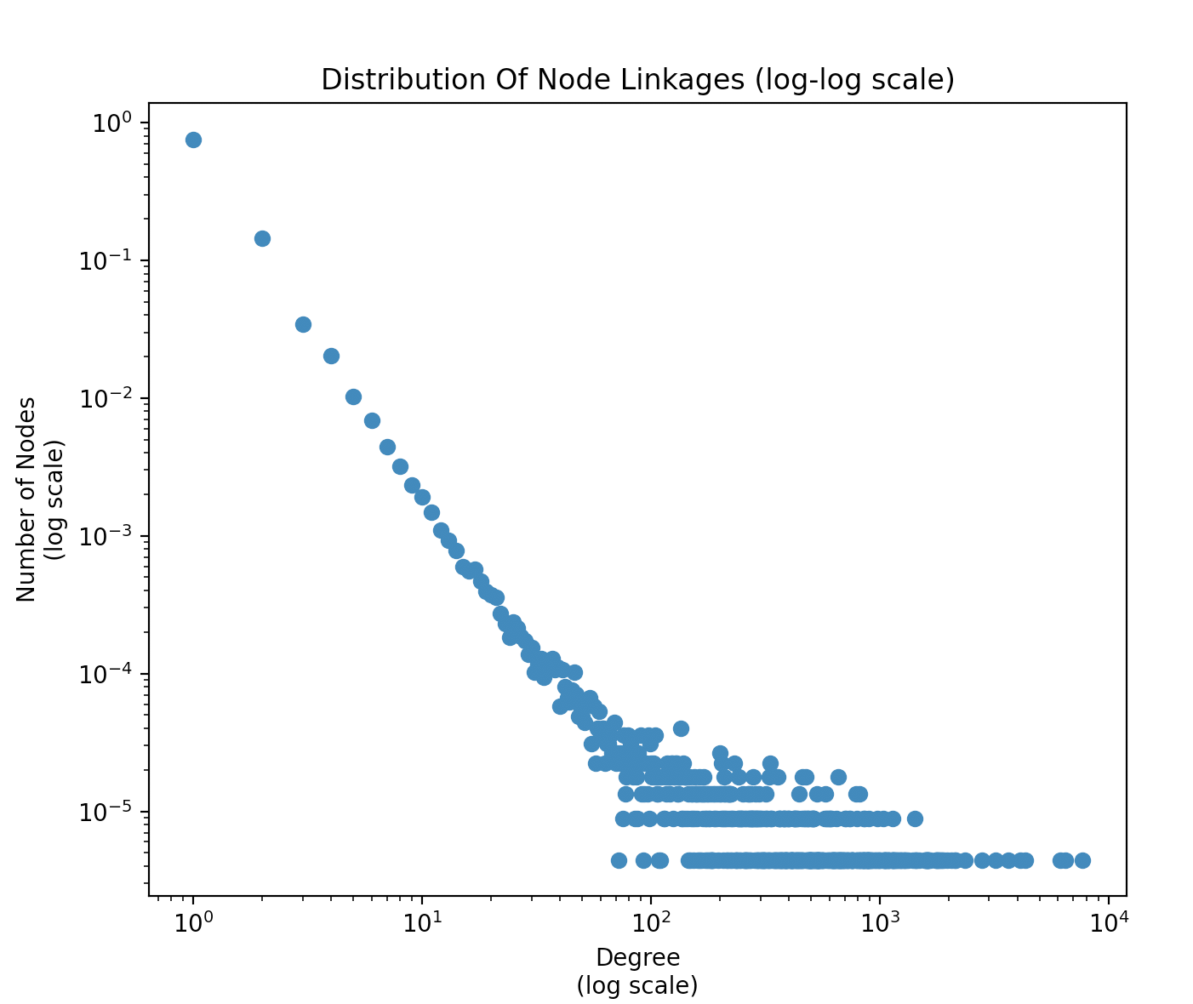
Degree Distribution of the 1st Large Component (Undirected Version)

Slide 26
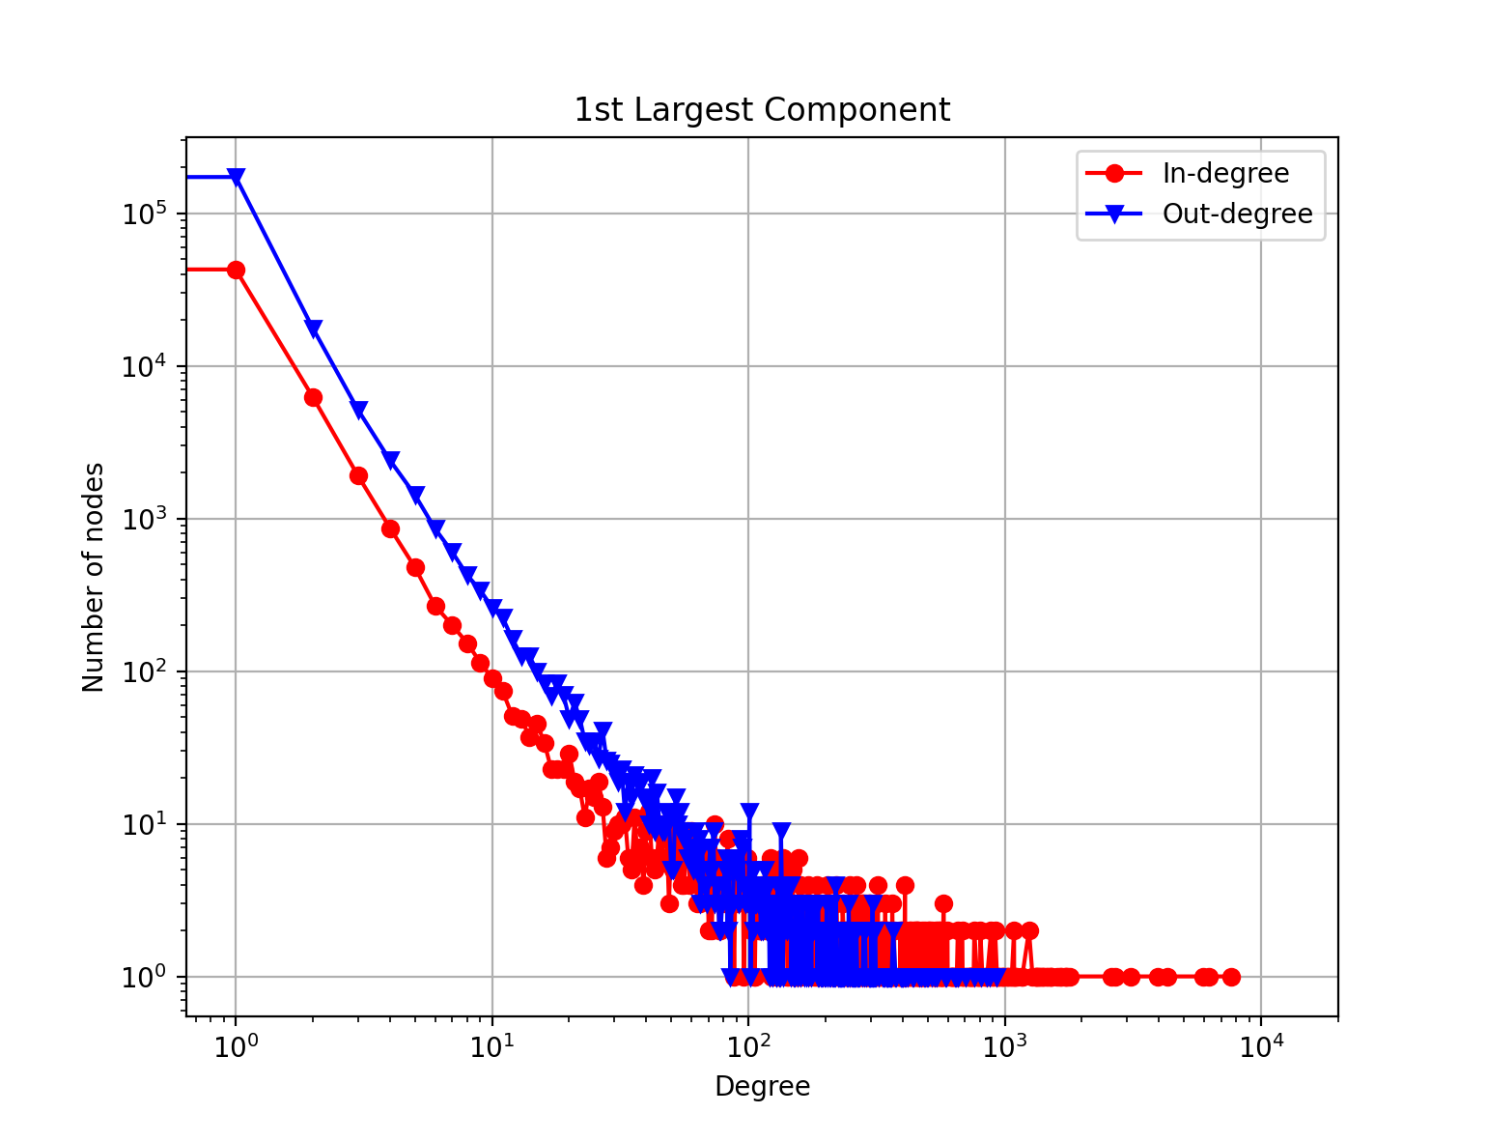
Power-law Distribution
γ ≈ 2.5

Slide 27
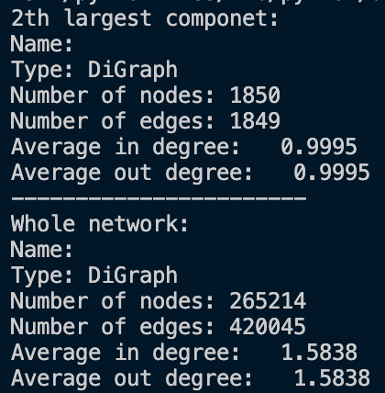
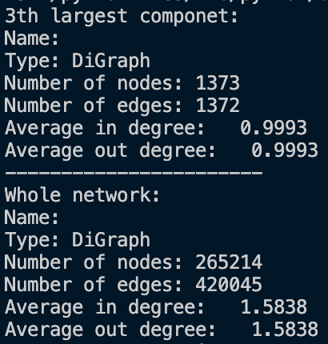
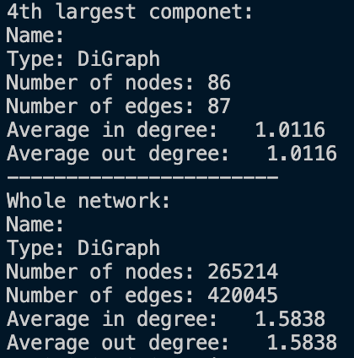
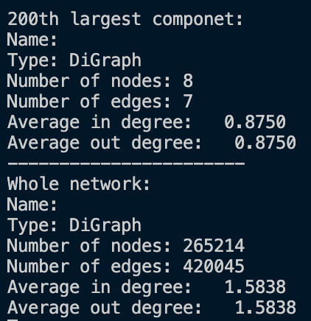

Slide 28
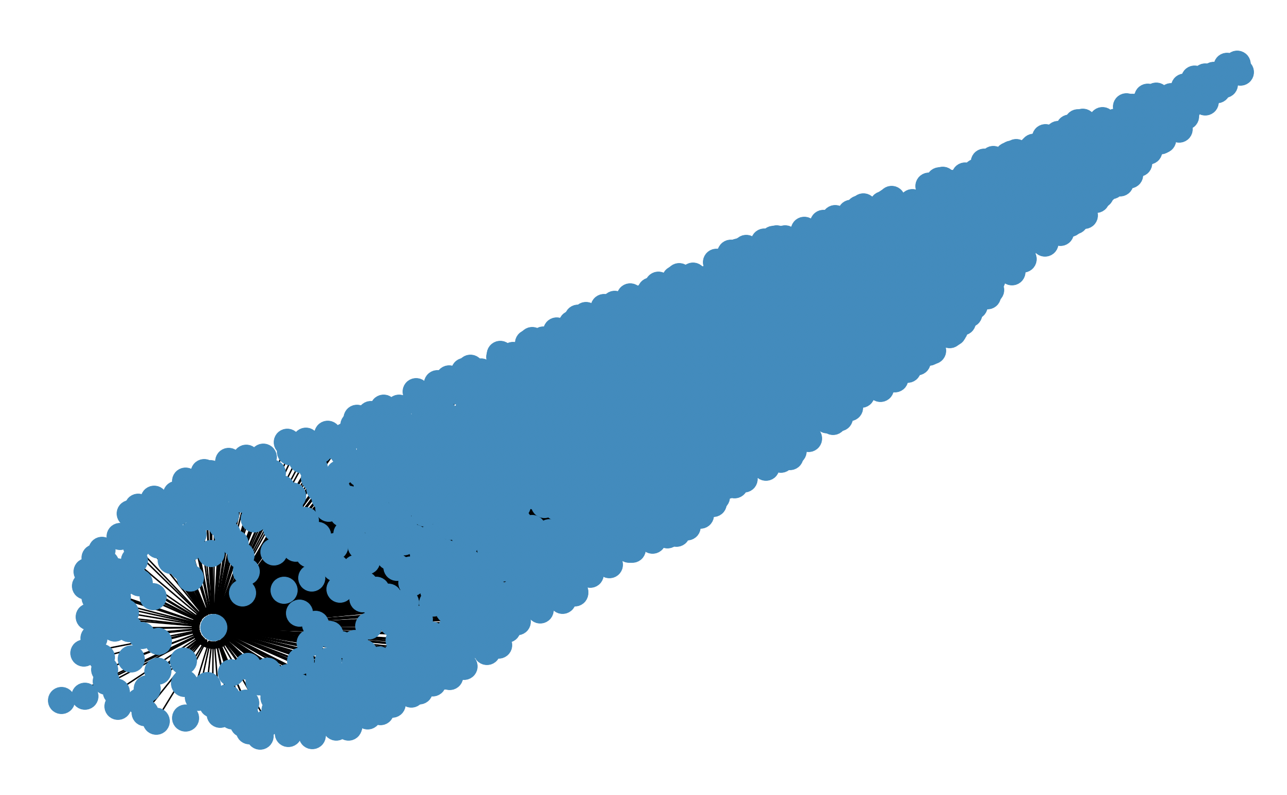
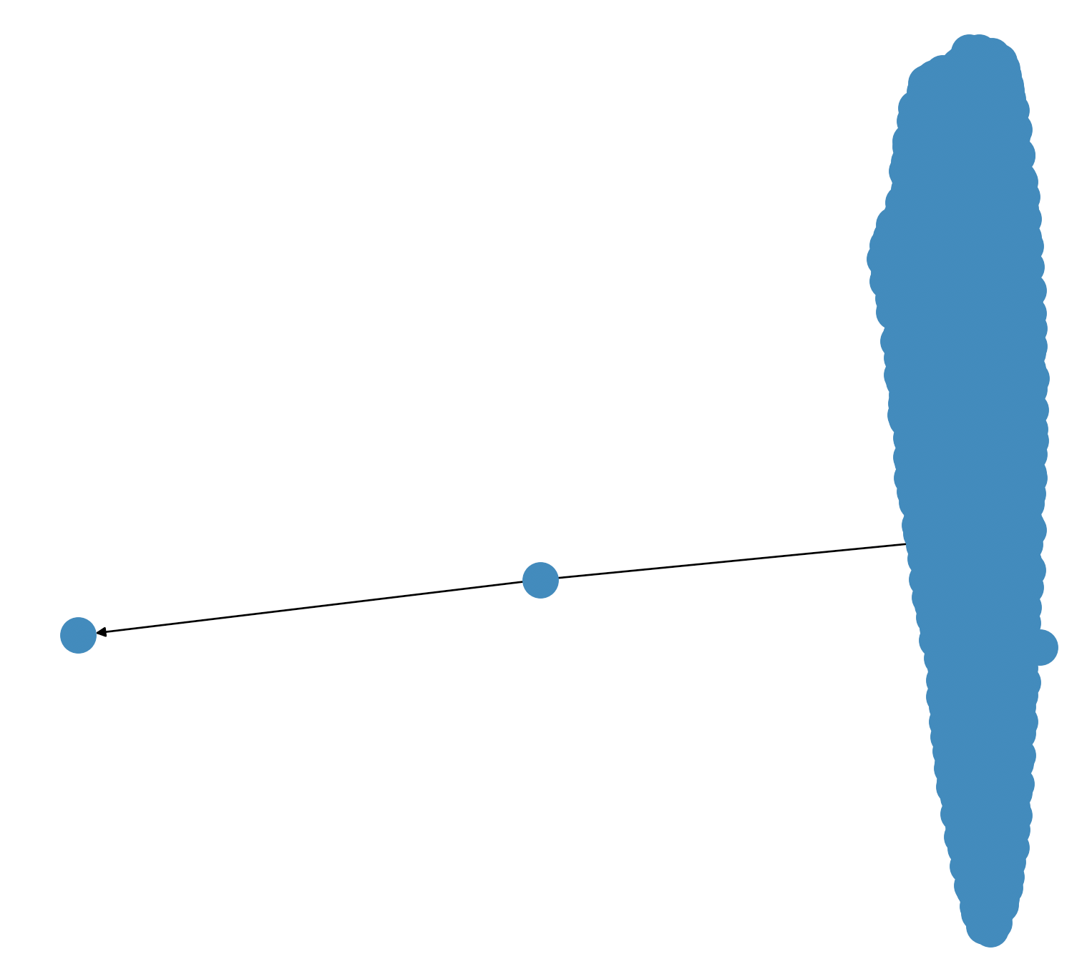
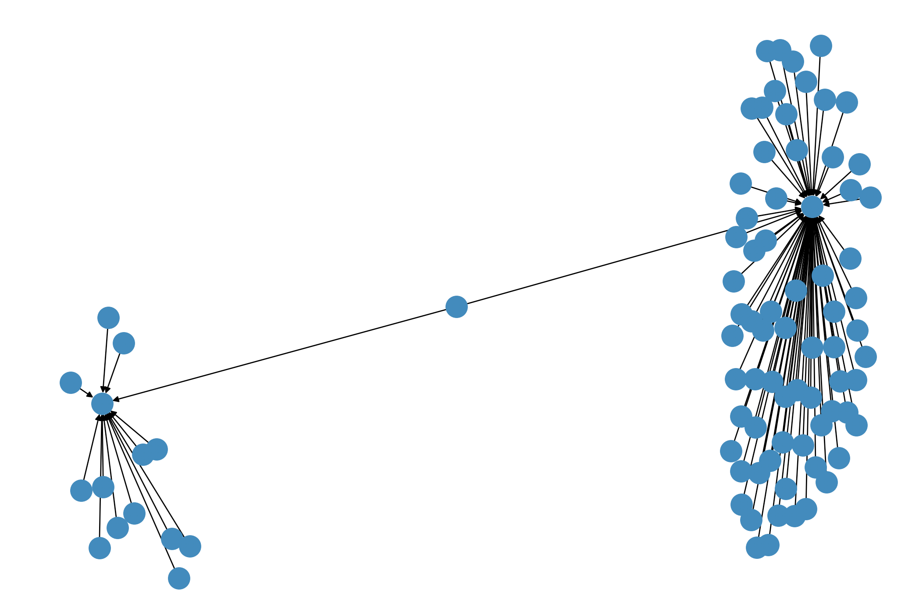
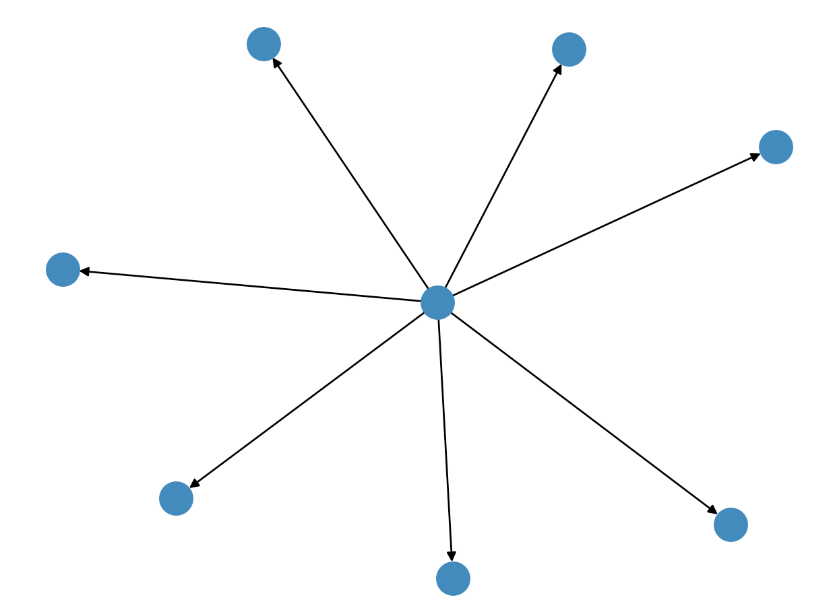
2nd Largest
3rd Largest
4th Largest
200th Largest

Slide 29
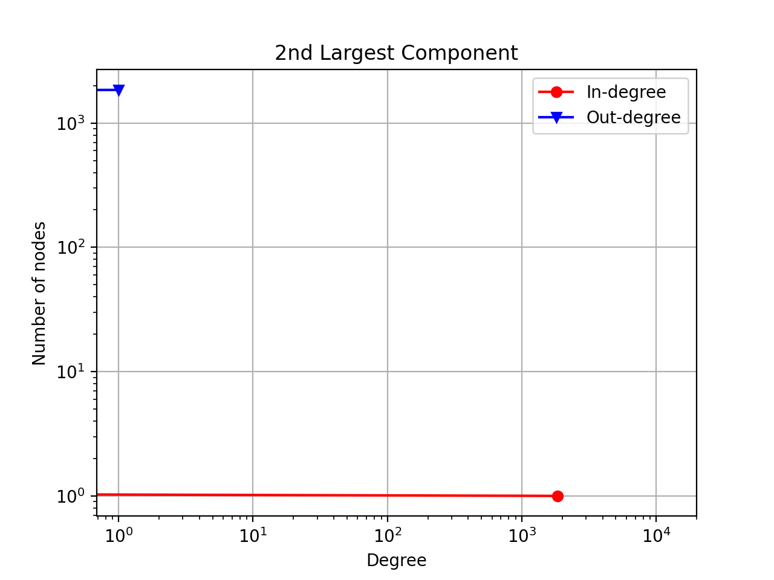
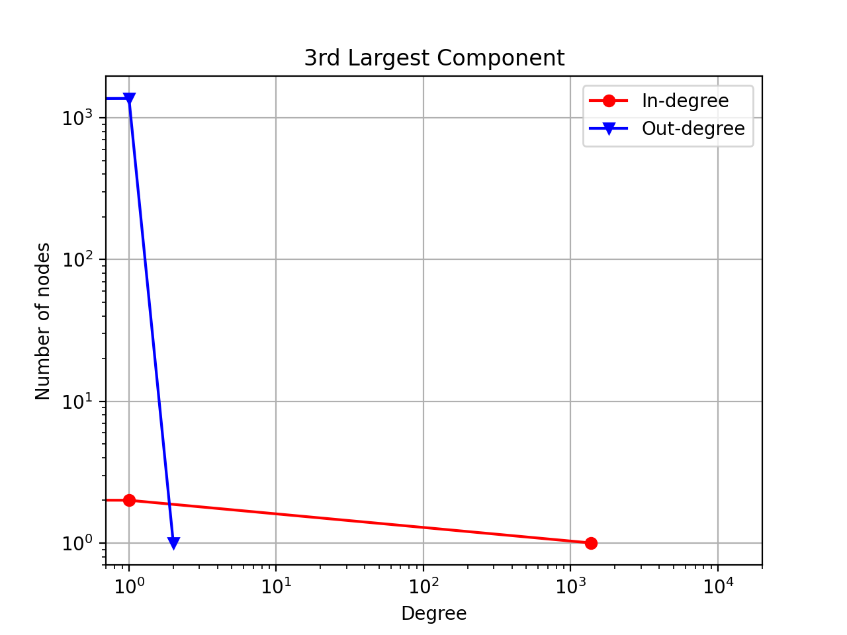
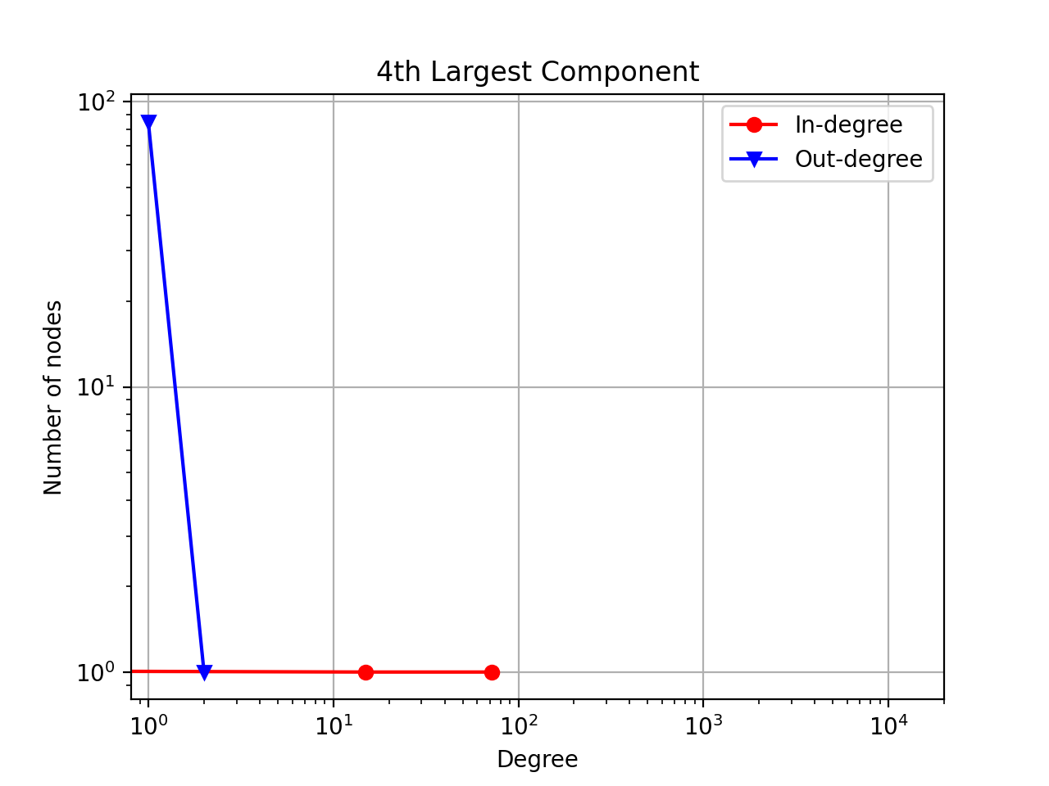
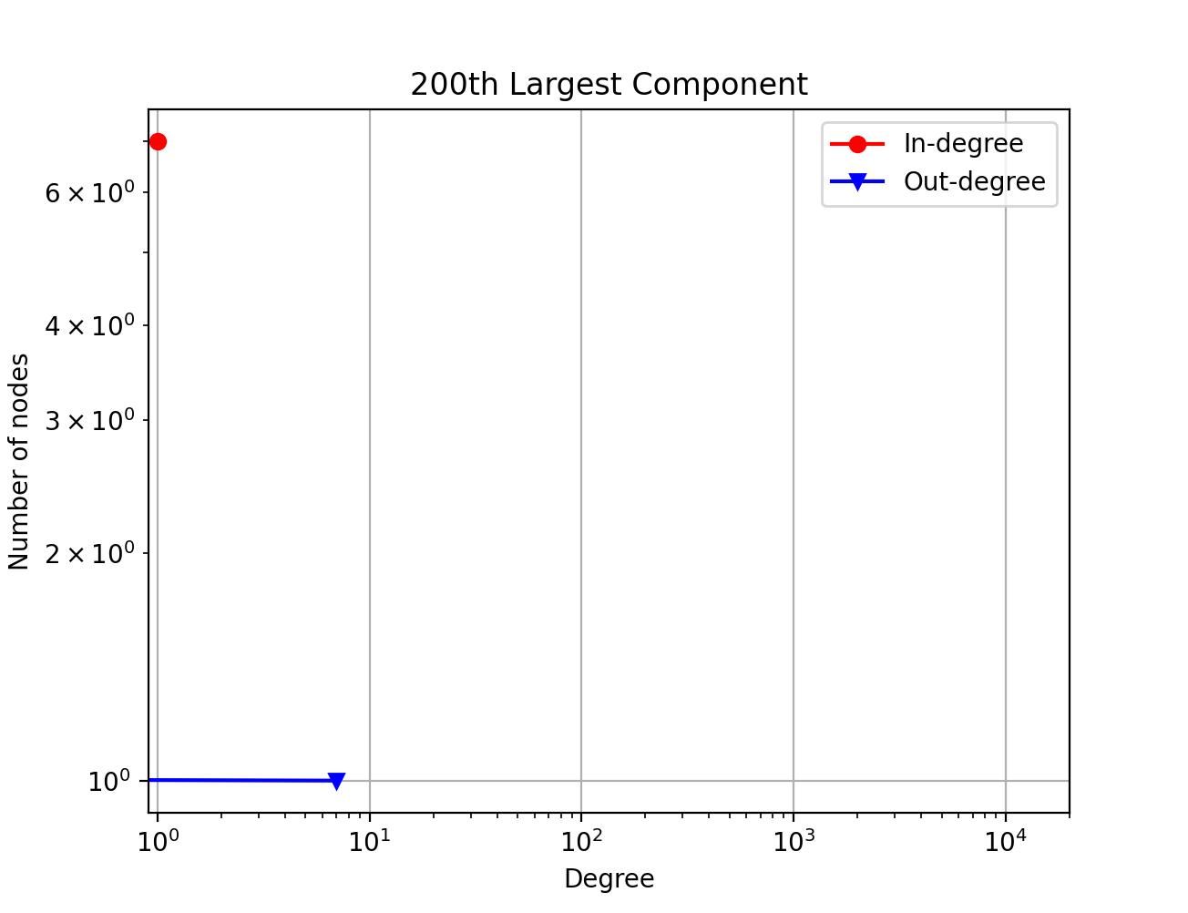

Slide 30

Conclusion
Scale-free γ ≈ 2.5
Hierarchy – There may exist a top-down hierarchy in the research institution, but it is hard to distinguish each layer. However, the general structure of this collaboration is clear to us now.
1. Within the Large Component (85%)
Around 1500 people form the collaborative network with extremely close connections.
The other 98% people represent the primary researchers who tend to connect with their upper counterparts directly.
2. Outside the Large Component (15%)
Simple Network with one central node as sender and several surrounded nodes as receiver.
May not necessarily belong to the research institution itself.
Spams, visitors, random emails…

Slide 31
Conclusion
What is the effect of removing the most central nodes?
When we remove sufficiently large number (threshold) of most central nodes, the network density decreases dramatically.
Are there any potential influencers other than the central node with the highest centrality?
The network is not limited to few influencers. Instead, the nodes (around 1500 nodes) that have the highest centrality in the 1st large component together form the influencers of this network.
Even though some of the nodes not in the 1st largest component have large degree, they have minimal centrality.

Slide 32
Implications
Possible Algorithm for Blocking Spam Emails
Effectively Manage/Categorize the Members in the Research Institution.
Further Research
Are there any potential influencers other than the central node with the highest centrality?

Slide 33

Thanks for Listening

Slide 34

References
https://www.cl.cam.ac.uk/teaching/1314/L109/tutorial.pdf
https://snap.stanford.edu/data/email-EuAll.html
https://networkx.org/documentation/stable/tutorial.html
Barabási, Albert-László. "Network science." Philosophical Transactions of the Royal Society A: Mathematical, Physical and Engineering Sciences 371.1987 (2013): 20120375
Codes From Dr. Wei Dai

